Slide 2
Tanking
Presentation
Ronald Rose
Technical Services Manager
10 FORMAL NZIA CPD POINTS

Slide 3
VISION
To be one of the world’s leading solution providers of high performance specialty building materials

Slide 4
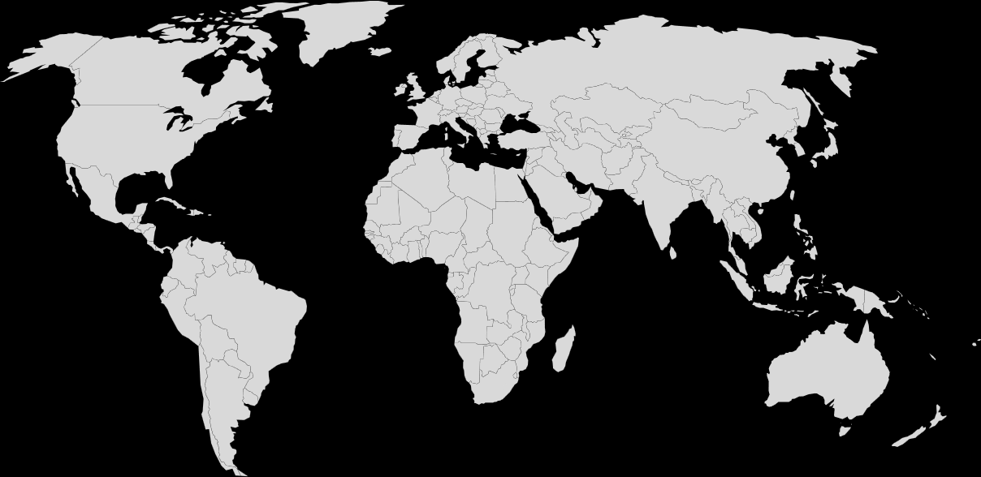
ARDEX Global
Present in over
100
Countries
More than
2,500
Different products
At a glance:
Founded In Germany 1949
Over 3,000 Employees
44 Production Sites
New Zealand centre for sheet membrane excellence
More than
18
Successful brands
Notes:
Messages: Credible company, proven products, continual investment in innovation and product development

Slide 5
ARDEX in New Zealand
Manufacturing site Christchurch
Sheet membranes
Liquid Membranes
Liquid adhesives
Flooring Adhesives
Sheet membrane manufacturing since 1967
Sales and warehousing in Auckland, Wellington, Christchurch. Other ARDEX brands available in NZ
CEMIX
DRYMIX
DUNLOP
DTA
WEDI
LOBA

Slide 6
ARDEX New Zealand
Helping you build better buildings
Long life products – designed to last the life span of the building
High coverage – maximise surface coverage
Ultra-fast, easy to use
Localisation focus
Toitū carbon reduce programme
Third party assessments - appraisals, marks and certificates

Slide 7
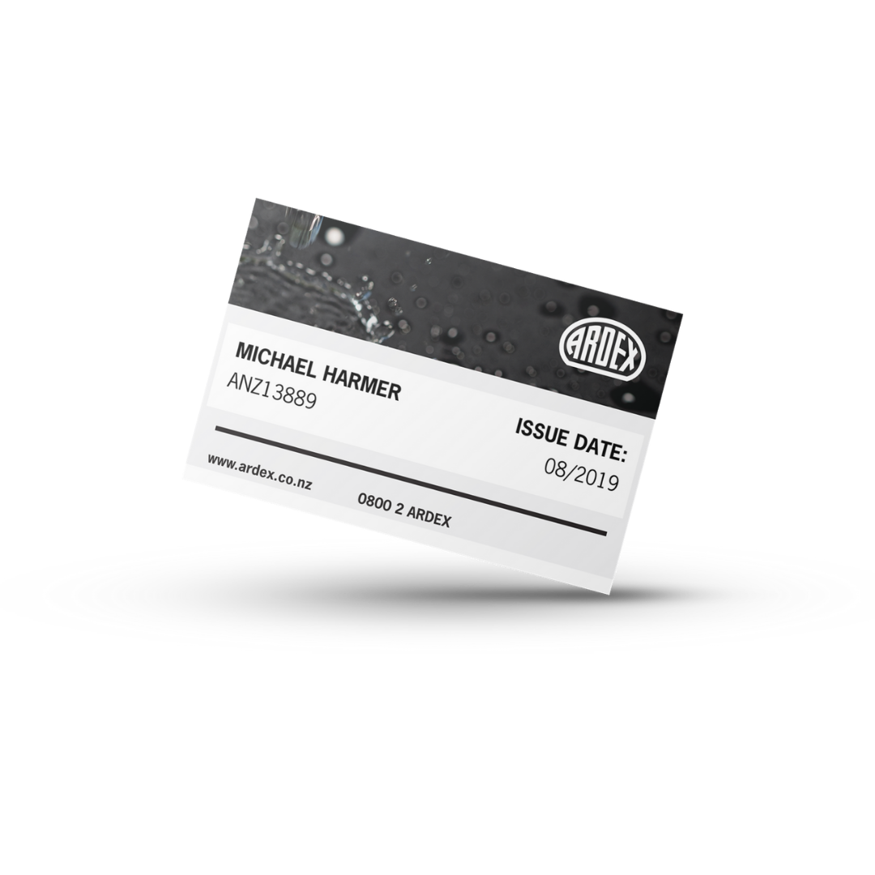
ARDEX TRAINING ACADEMY
RAISING THE STANDARD - NZ WIDE
ARDEX
AUCKLAND
1 Theory Room
1 Practical Room
Capacity: 16
Custom training facilities in Auckland, Wellington, Christchurch
Regional training in local venues
20 courses offered
Over 1,000 participants yearly
ARDEX trained installer accreditation and access to ARDEX Warranty System
ARDEX host apprenticeship training
ARDEX
WELLINGTON
Designated training zone
Capacity: 8
ARDEX
CHRISTCHURCH
1 Theory Room
1 Practical Room
Capacity: 14

Slide 8
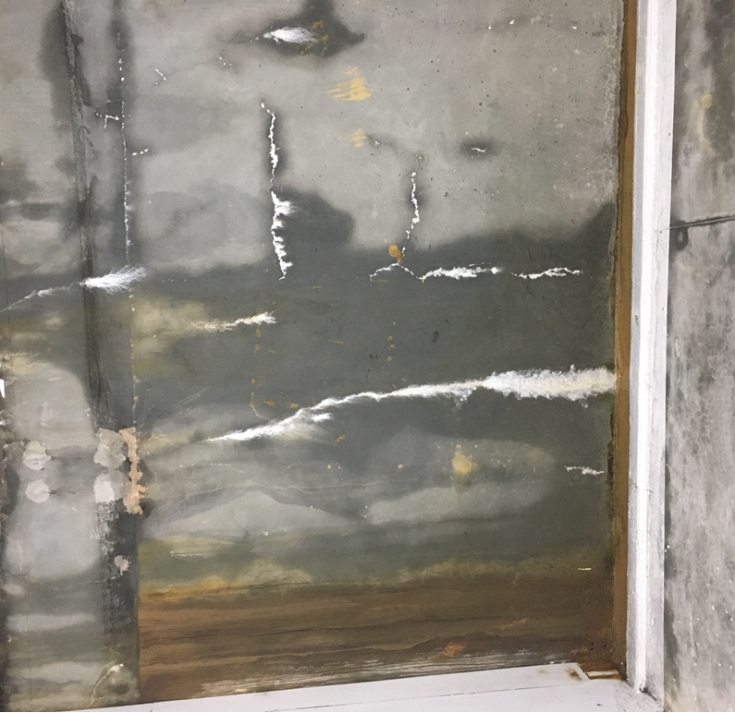
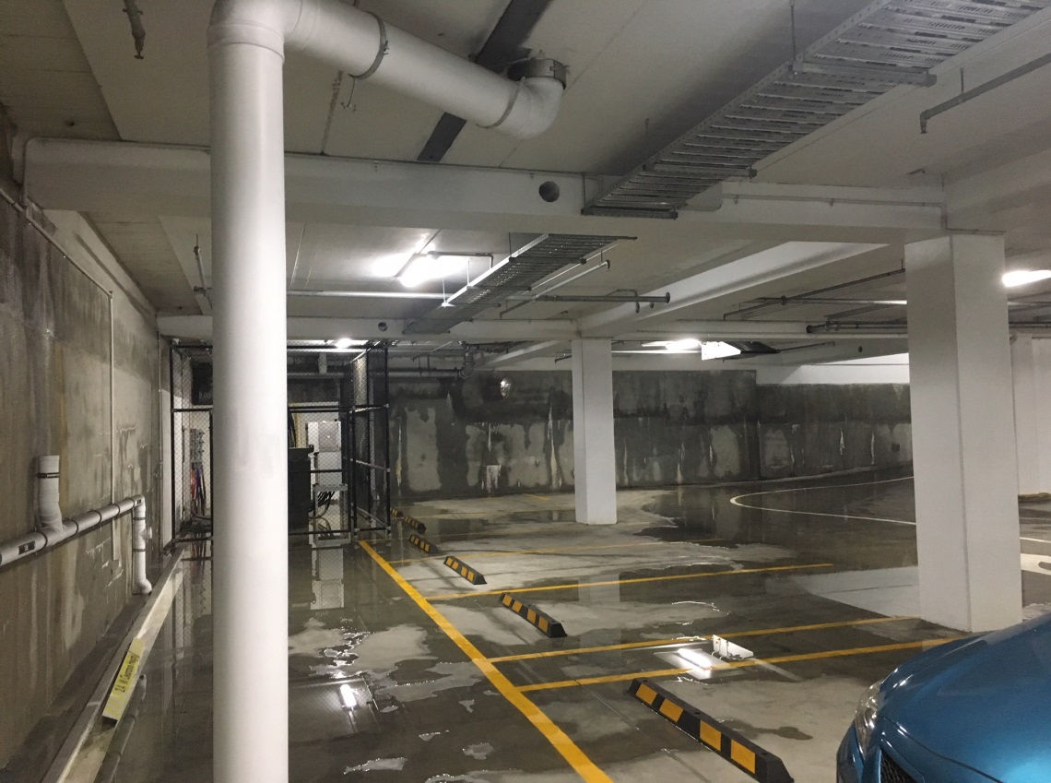
Below grade waterproofing
Bunnings Grey Lynn: $42M build – opened 2017

Slide 9
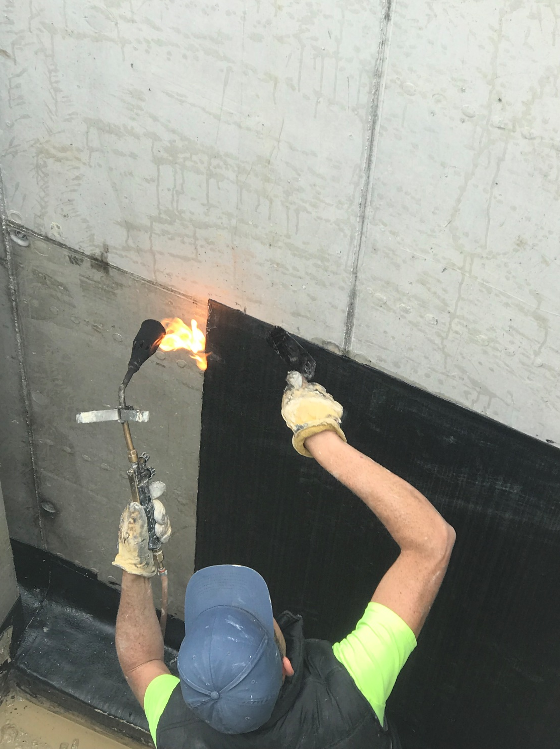
Below grade waterproofing - “out of sight out of mind”
Often it is one area that is neglected
Lack of foresight can be very costly
Consideration of all factors is critical to select the most appropriate product for the application
Cost shouldn’t be a determining factor
Use a system - rather than mixing horizontal damp proof course with vertical tanking
Below Grade
Waterproofing

Slide 10
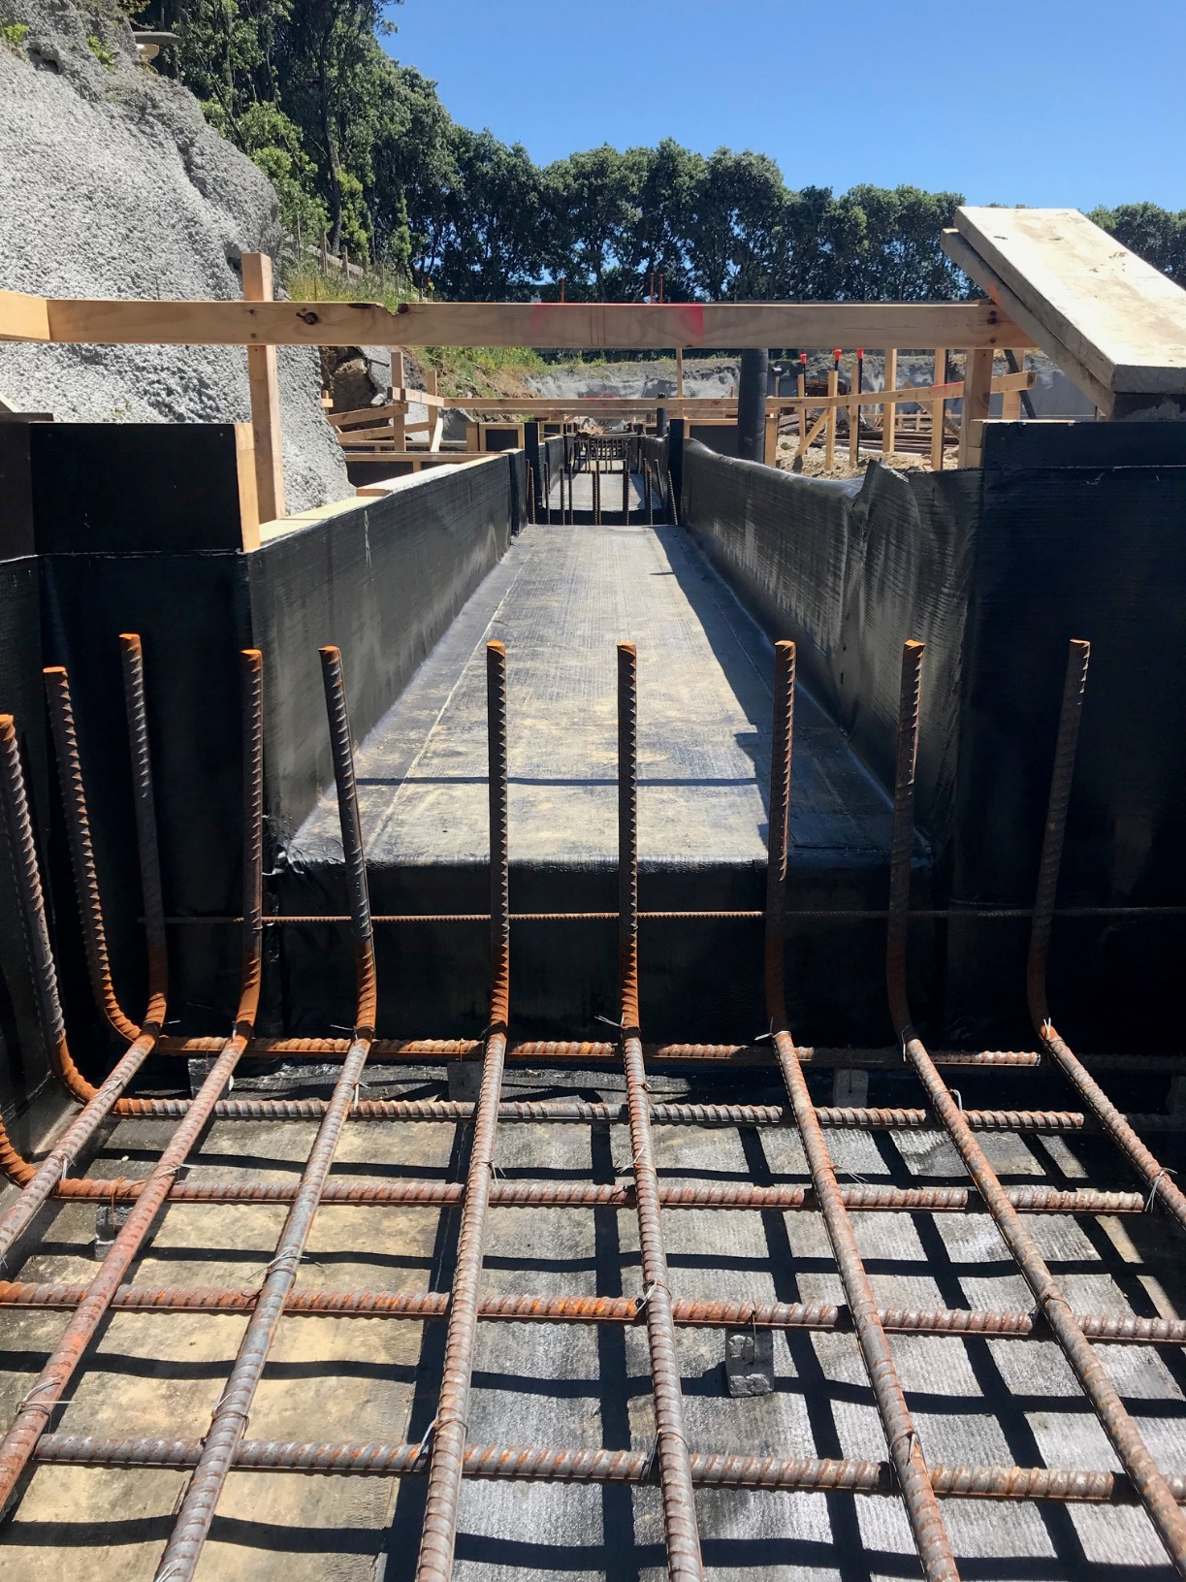
Weather
Weather plays an important part of any installation and needs to be appreciated and understood
Preparation
All edges should be radiused
Fillet installed at changes in direction
Secondary detailing at critical points - most membranes
General Considerations

Slide 11
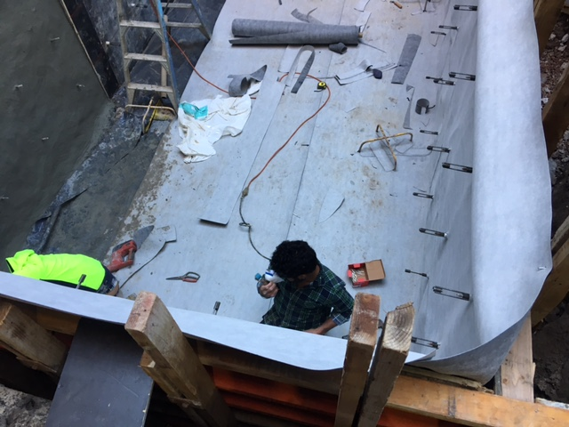
Finishing Details
Most bituminous membranes are not UV stable and finishing details must be thought of well in advance.
Protection boards used prior to backfilling
Sub trades
General Considerations

Slide 12
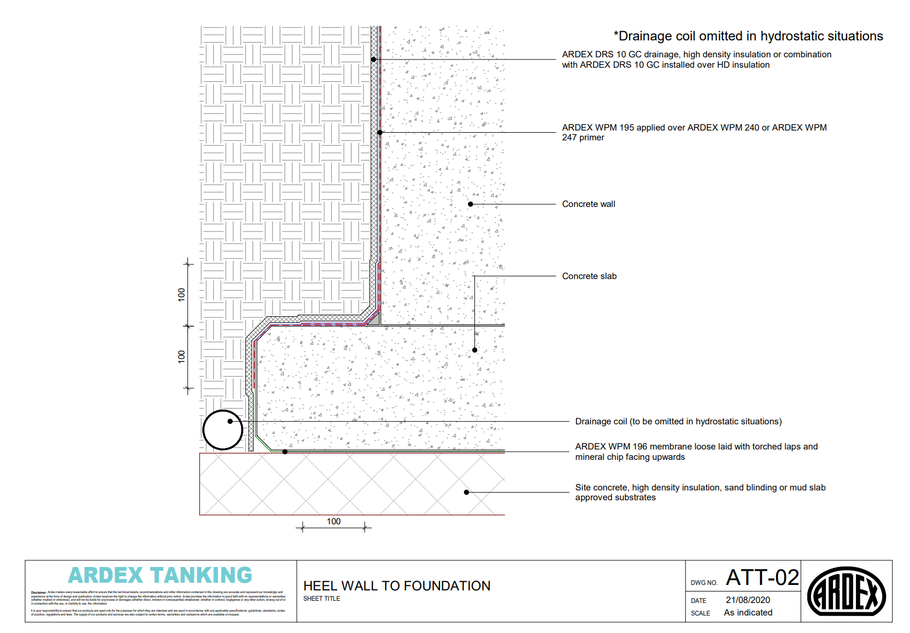
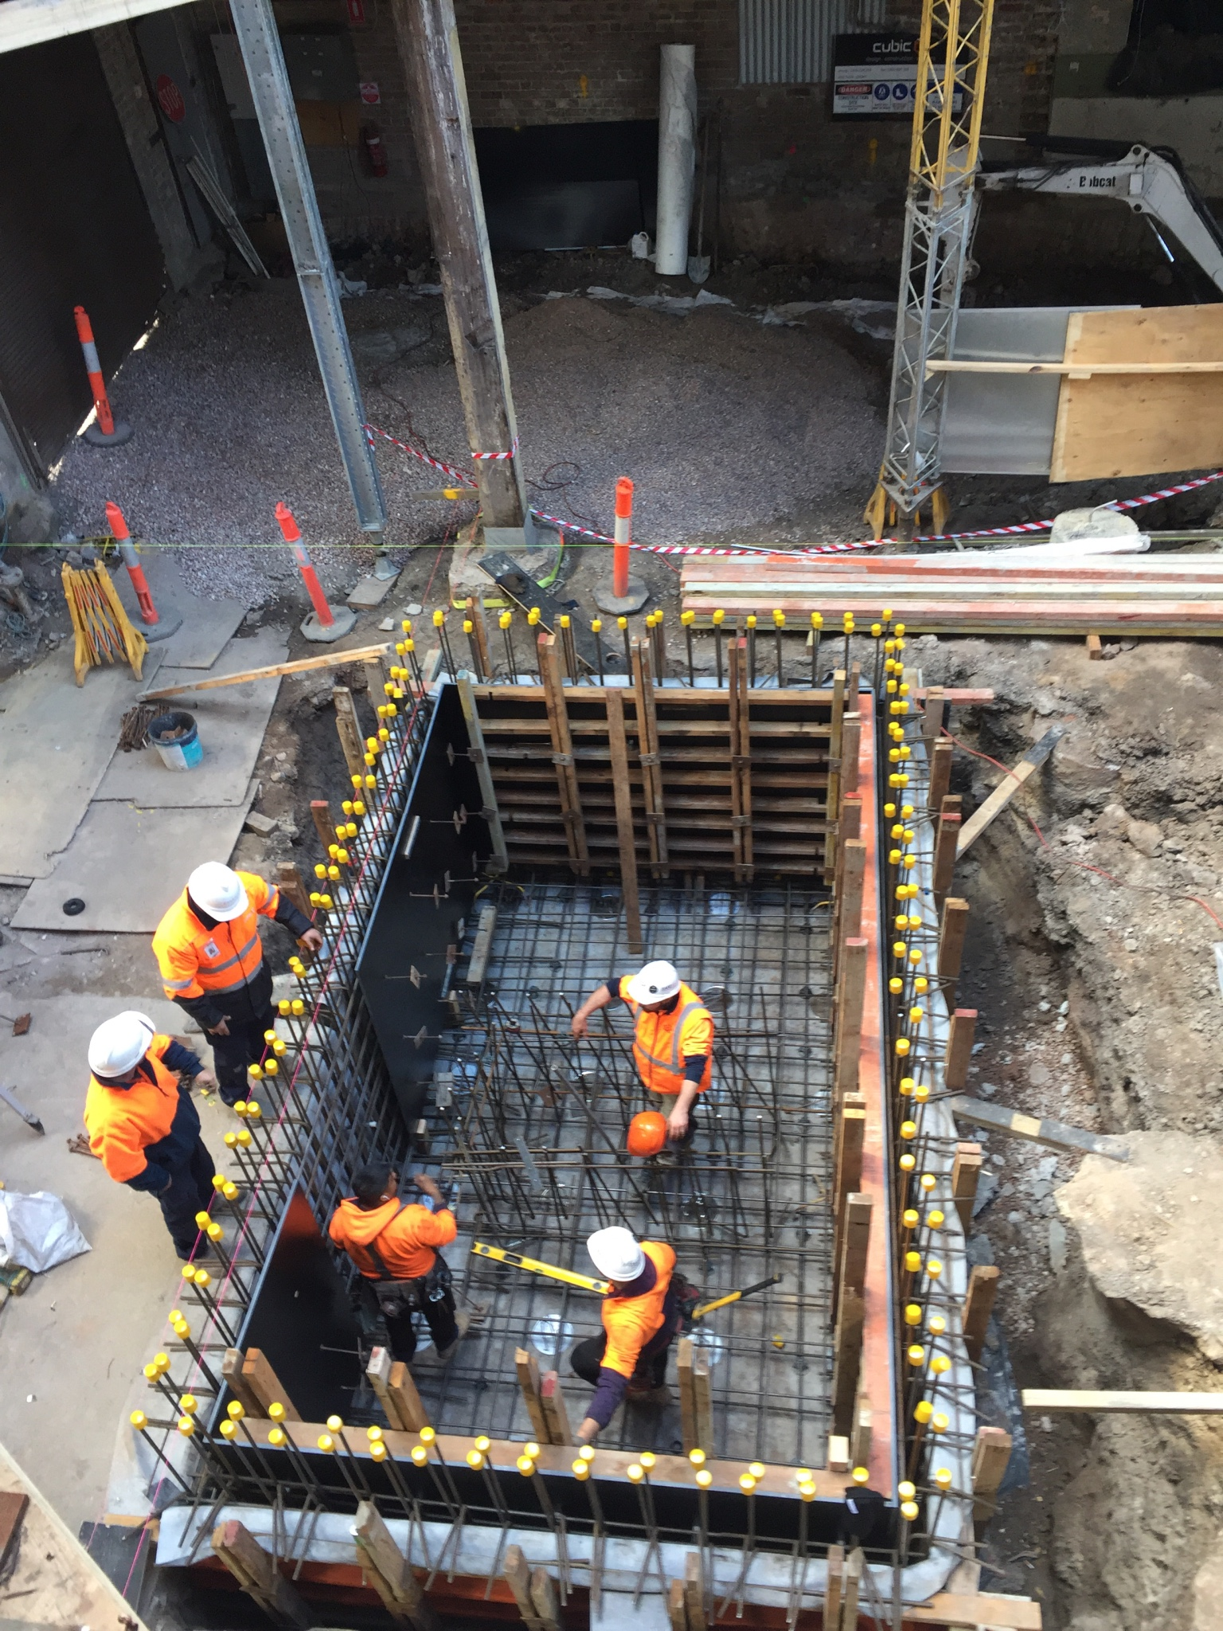
Various membrane systems are available they include:
Positive side
Negative side
Blind side
4 membrane categories
Liquid applied
Sheet applied
Bentonite clay
Cementitious systems
Waterproofing Membranes

Slide 13
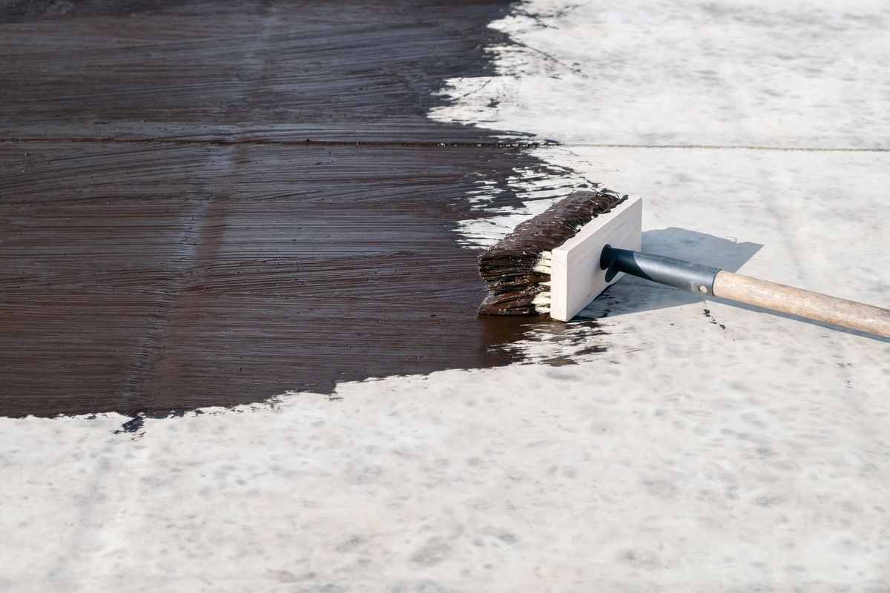
These systems include:
Urethanes, rubbers, plastics and modified bitumen emulsions
Some are mesh reinforced
Generally reliant on a film build thickness of over 1.0mm
4 Categories Of Tanking Membranes
Liquid applied

Slide 14
Things to consider:
Is it the right product for the right situation and does it have the required testing?
What is the expected life span?
Will it withstand hydrostatic pressure?
How to ensure the installer applies the right film build?
Does it meet B2- 50 years?
Concrete block walls should be rendered first to minimise risk of cracking along mortar joints
Detailing changes in direction and expansion joints is critical
4 Categories Of Tanking Membranes
Liquid applied

Slide 15
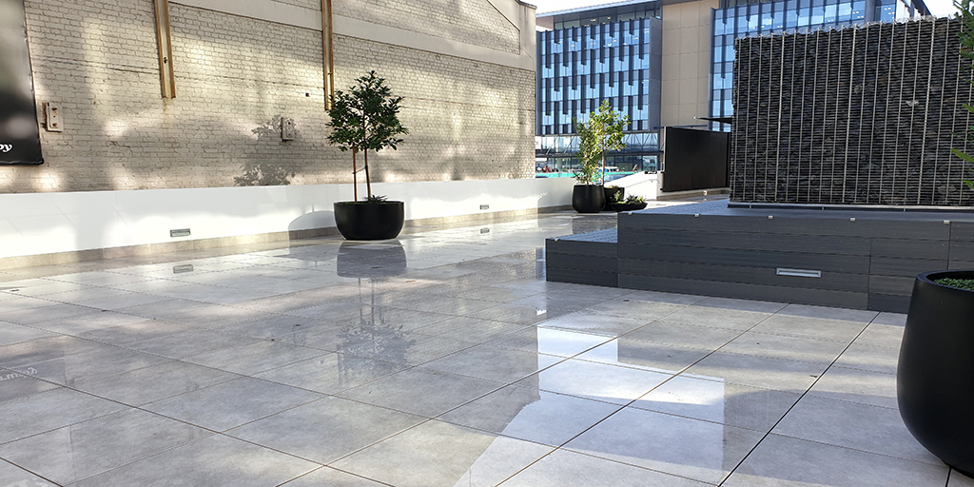
4 Categories Of Tanking Membranes
Sheet applied systems
These systems include:
Thermoplastics, vulcanised rubbers, rubberised bituminous membranes
Thickness various from 1mm for sheet rubber to 8mm for double layer torch applied systems
They can be loose hung or fully adhered

Slide 16
Things to consider:
Is it the right product for the right situation?
Has required testing i.e., geothermal, methane, radon
Installed by an approved installer?
Does it meet B2- 50 years?
Sheet fully bonded – reduces the risk for lateral migration should a leak ever occur
Detailing of changes in direction and expansion joints is critical
4 Categories Of Tanking Membranes
Sheet applied systems

Slide 17
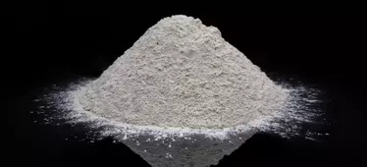
Systems based on sodium bentonite and applied onto a carrier fabric or sheet
Acts as waterproofing by swelling when exposed to moisture becoming impervious to the flow of water
Can swell up to 10-15 percent of the original thickness so product must be kept confined to work
4 Categories Of Tanking Membranes
Bentonite clays

Slide 18
Things to consider:
Is it the right product for the right situation and does it have the required testing?
Must be installed by an approved installer
Sheets correctly overlapped and pinned?
If not confined, it may shrink upon drying creating gaps that can cause the waterproofing to fail
Waterstop bars are critical
4 Categories Of Tanking Membranes
Bentonite clays

Slide 19
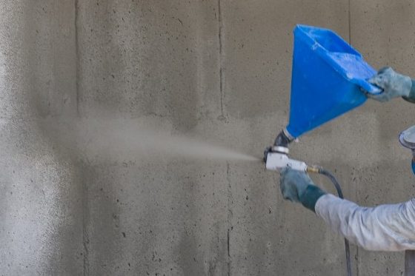
These systems are based on cement combined with an active waterproofing agent
Can be metallic, crystalline, chemical and acrylic modified
Should only be considered as secondary protection (back up) to positive side waterproofing
4 Categories Of Tanking Membranes
Cementitious systems

Slide 20
Things to consider:
Is it the right product for the right situation?
Must be installed by an approved installer
If the structure moves and cracks this generally renders the waterproofing null and void
Detailing
4 Categories Of Tanking Membranes
Cementitious systems

Slide 21
WANNA GET TANKED?
Is there hydrostatic pressure present?
(i.e. no drainage intended)
ARDEX Tanking
YES
NO
Heat welded
seams
cold seams
For extra strength or where hot asphalt is applied WPM 5000HD
Shelter Seal
WPM 3000
Do you require a root inhibitor?
NO
YES
Underslabs
WPM 196
YES
Confined Space
WPM 1500
Vertical Surface
WPM 195
ARDEX
Root Repell

Slide 22
Waterstops should be used in all construction joints in below grade applications
Waterstops are generally based on bentonite or butyl rubber technology and swell to many times its size restricting the progress of water
If PVC waterstops are used, it is important to ensure these are welded correctly
Confirm correct product is selected for the application e.g.: don’t use standard waterstops in a marine environment
Waterstops Are Critical

Slide 23
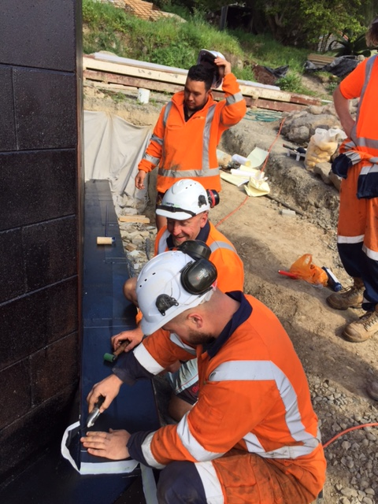
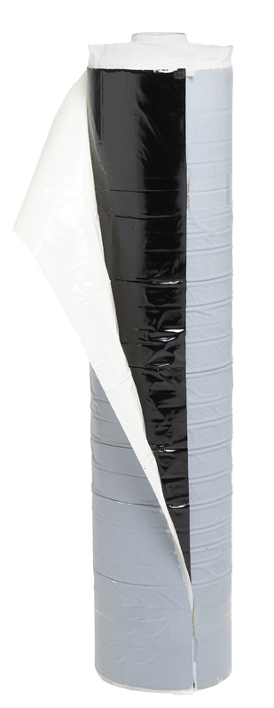
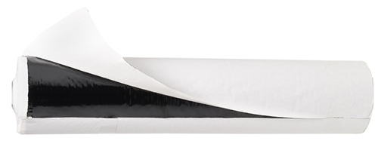
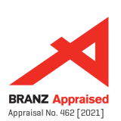
ARDEX Shelterseal WPM 3000X/ARDEX WPM 5000HD
High flexibility Styrene-Butadine-Styrene (SBS) peel and stick membranes
Non hydrostatic situations
Resistant to chemical attacks
Withstand thermal movement
Methane and Radon gas barrier
WPM 5000HD mesh surface for application of hot asphalt
Notes:
Talk about what is happening in the image

Slide 24
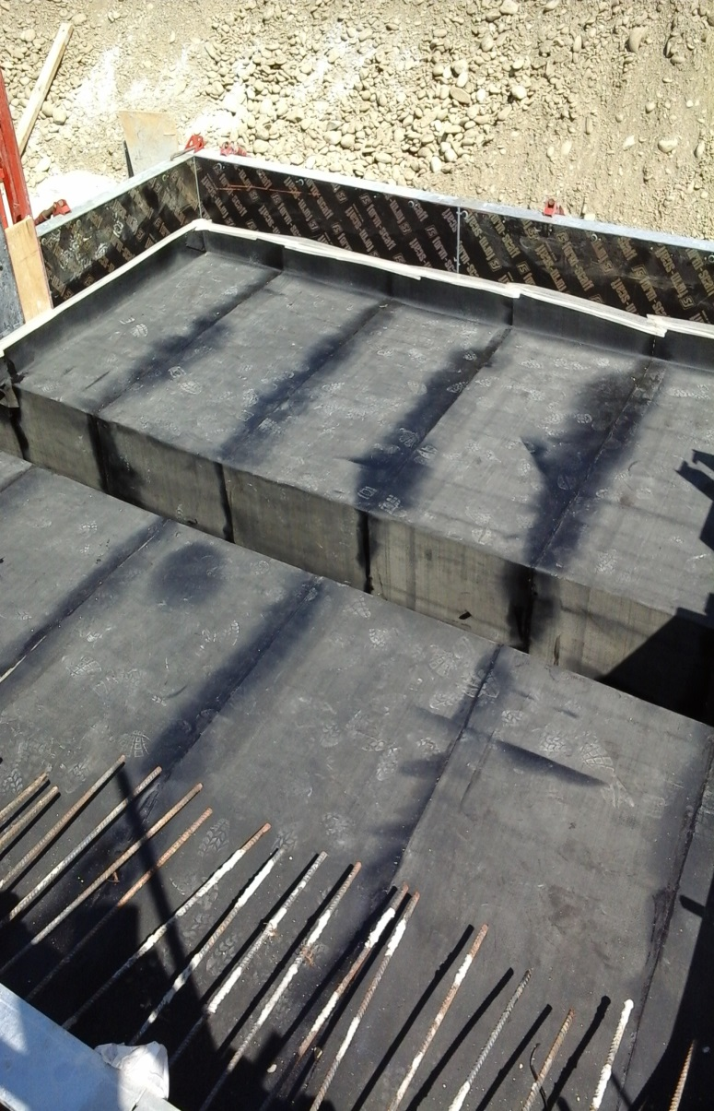
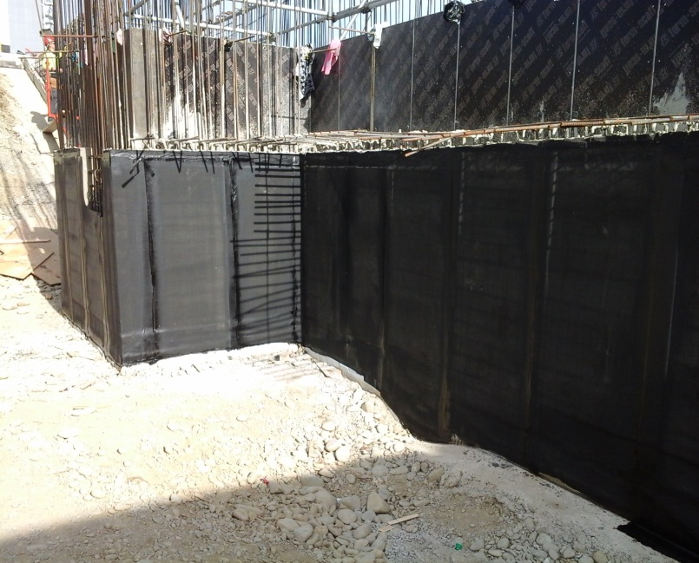
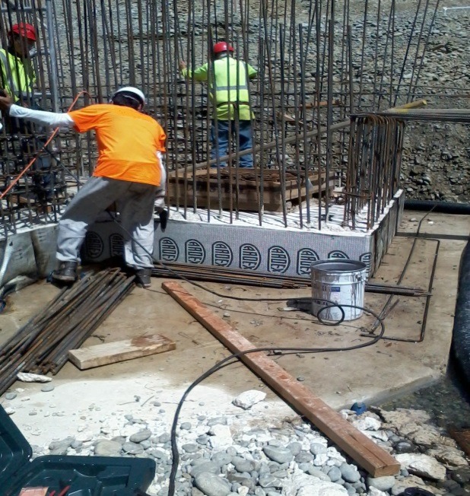
ARDEX WPM 195 AND ARDEX WPM 196
Torch applied SBS
High flexibility at sub-zero temperature
Accommodates structural movements
Resistant to chemical attacks
Withstand thermal shocks
Mineral chip finish for high adhesion to concrete (WPM 196 only)
Notes:
Talk about image – what are we seeing?

Slide 25
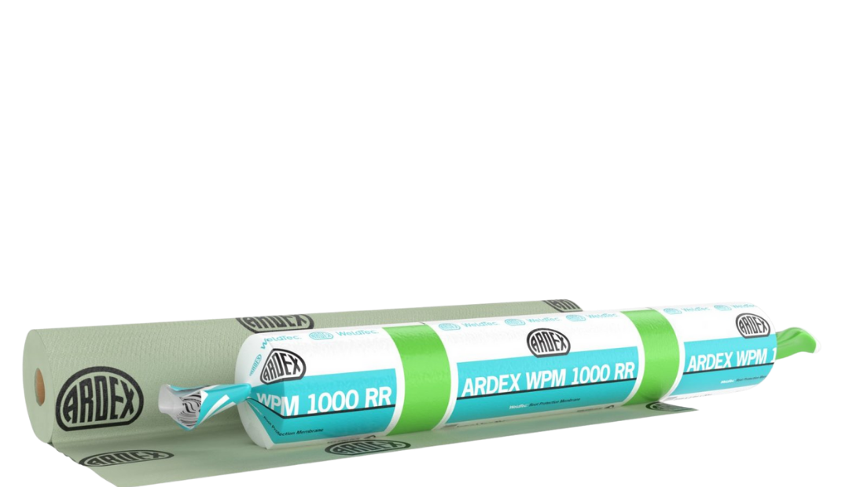
ARDEX WeldTec WPM 1000RR
Flexible single ply membrane for roof gardens, planter boxes and foundation protection
WeldTec - heat weldable technology
1.0mm synthetic sheet
Root inhibitor has passed FLL test for root and rhizomes penetration – repels, not harms
Notes:
Forschungsgesellschaft Landschaftsentwicklung Landschaftsbau e.V. (FLL) - Method for testing resistance to root perforation for flexible sheets for roof waterproofing“ with emphasis on strain by plant roots.

Slide 26
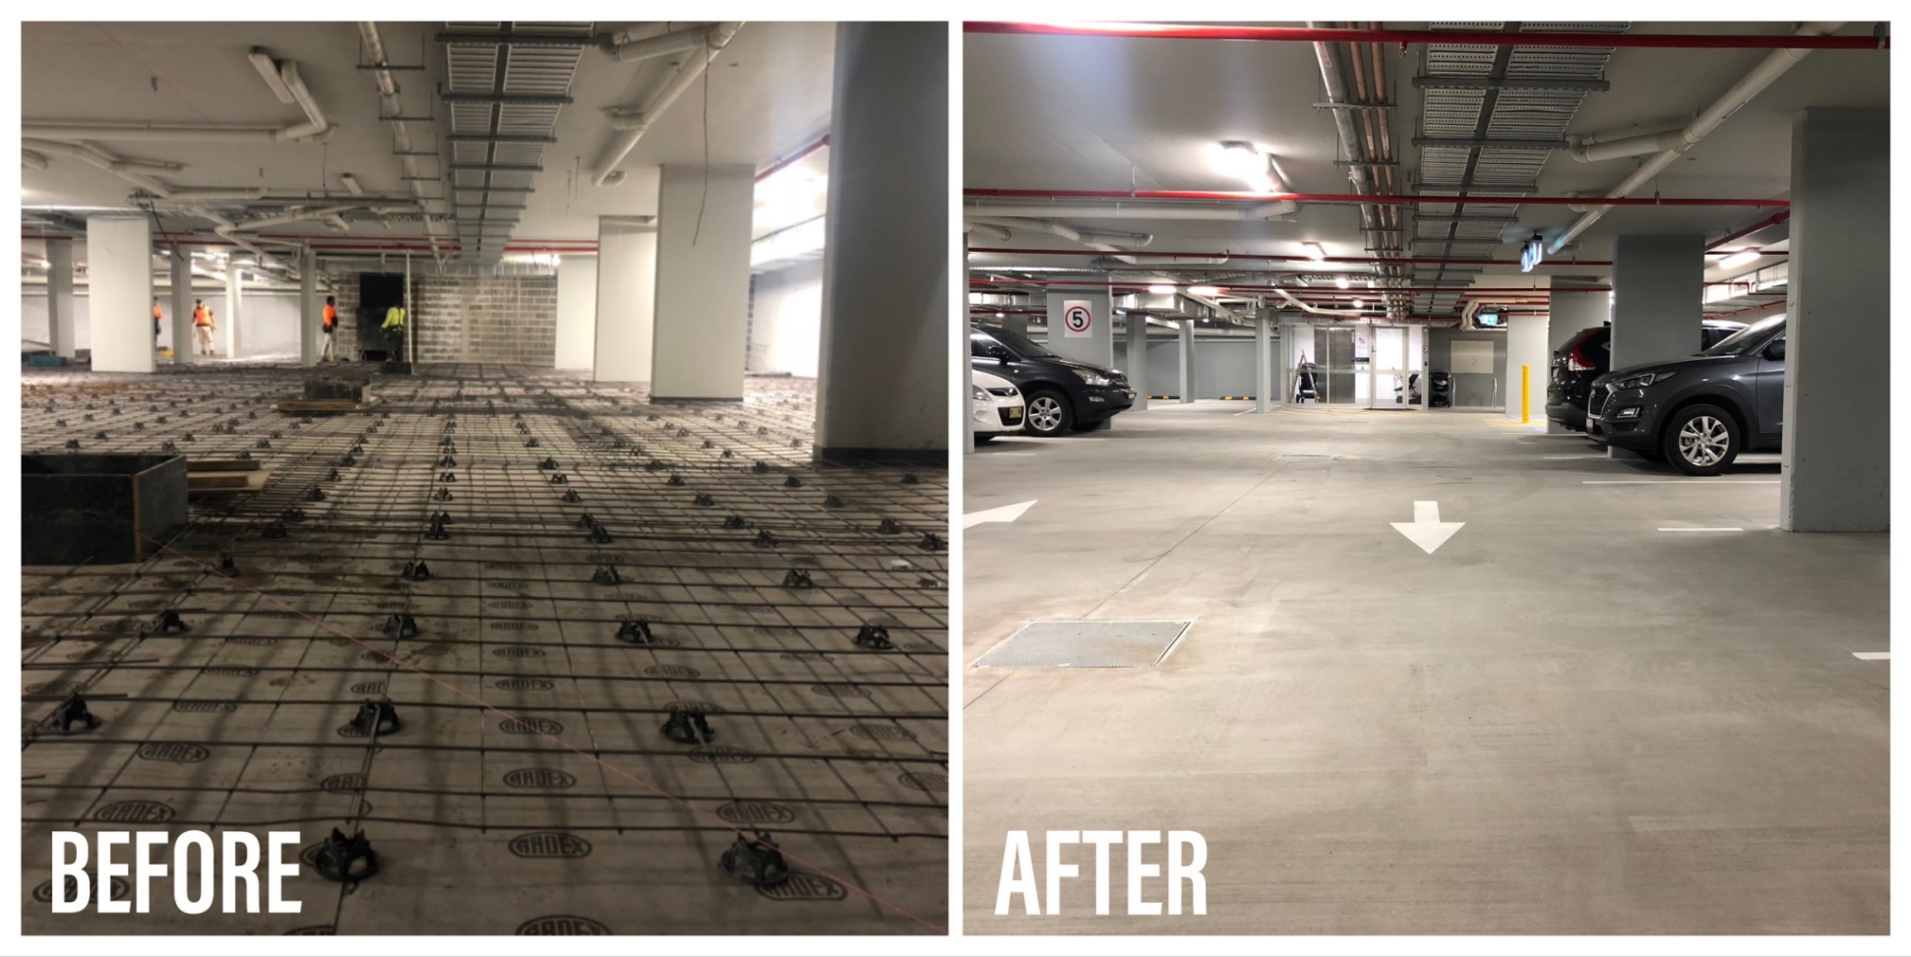
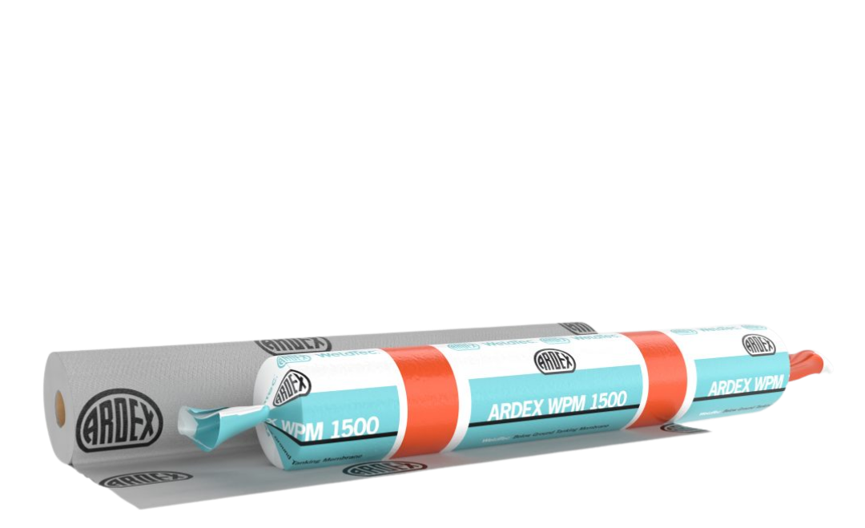
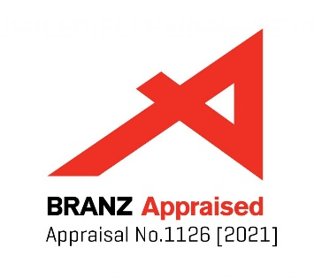
ARDEX WeldTec WPM 1500 Tanking membrane
WeldTec fleece lined, heat welded detailing creates very strong watertight laps and a unique continuous waterproofing membrane
Tested - suitable for geothermal areas
High chemical resistance and hydrostatic head (70m)
Hydrogen sulphide, radon and methane gas diffusion barrier
Notes:
Talk about the photo

Slide 27
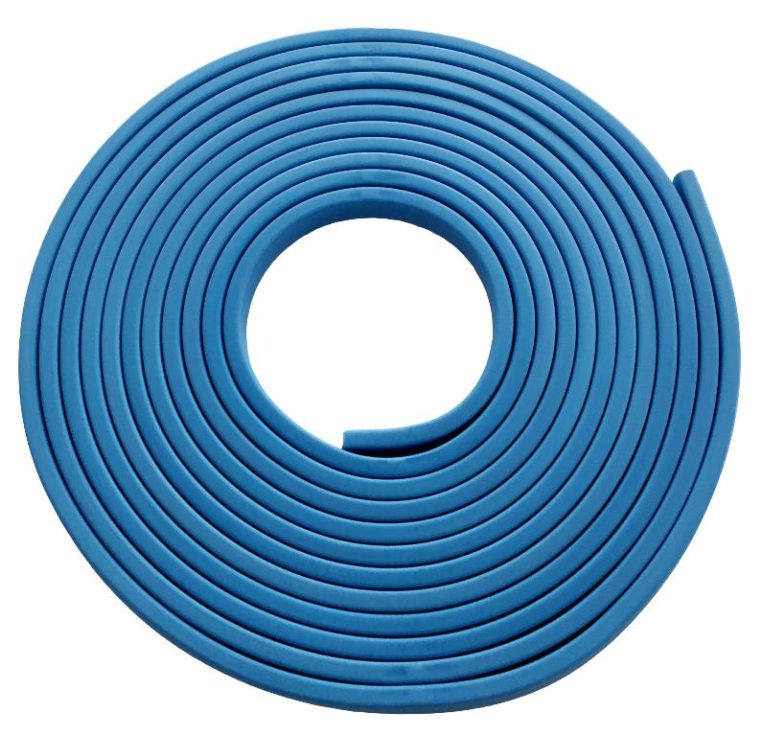
Hydrophilic butyl waterstop
Situated at critical joints, junctions and details
WPM 1955 is for all environments including marine
Designed to not swell during concrete curing
Cost effective second line of defence
ARDEX WPM 1955

Slide 28
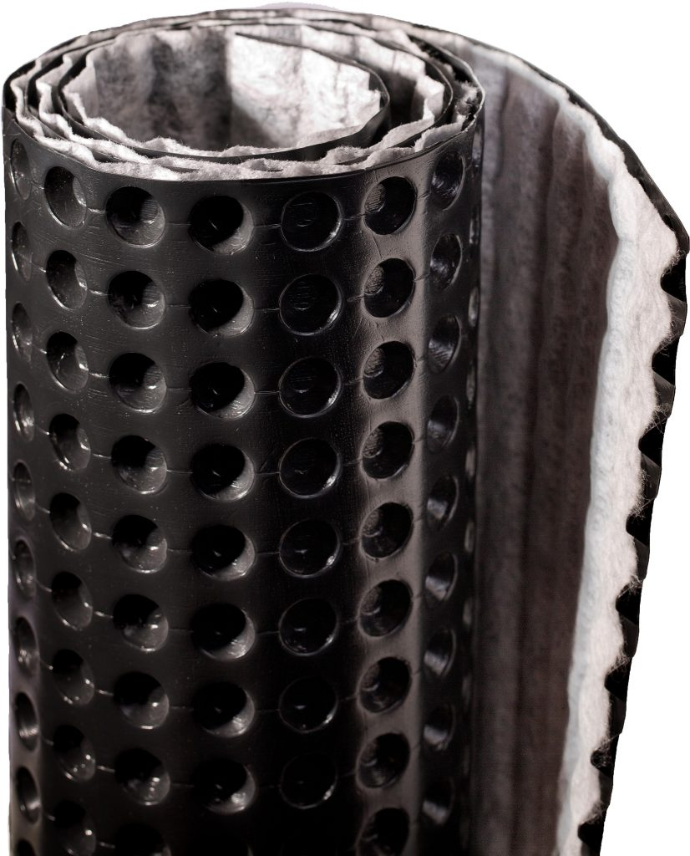
Provides effective protection of the waterproofing membrane
Provides effective drainage of sub-surface water
Excellent compressive strength
High resistance to chemical attack
100% recycled material
ARDEX DRS 10 GC

Slide 29
Design of structure - can the tanking be completed in sequence? Footing/Wall Junction
Substrate?
Choice of membrane is correct for conditions
Is a gas barrier required?
Correct testing? e.g.: hydrogen sulphide for Rotorua, not sulphuric acid solution
Durability? 50 years minimum - manufacturers warranty? Choice of installer – installer warranty?
Is there drainage?
Hydrostatic pressure?
Critical Considerations

Slide 30
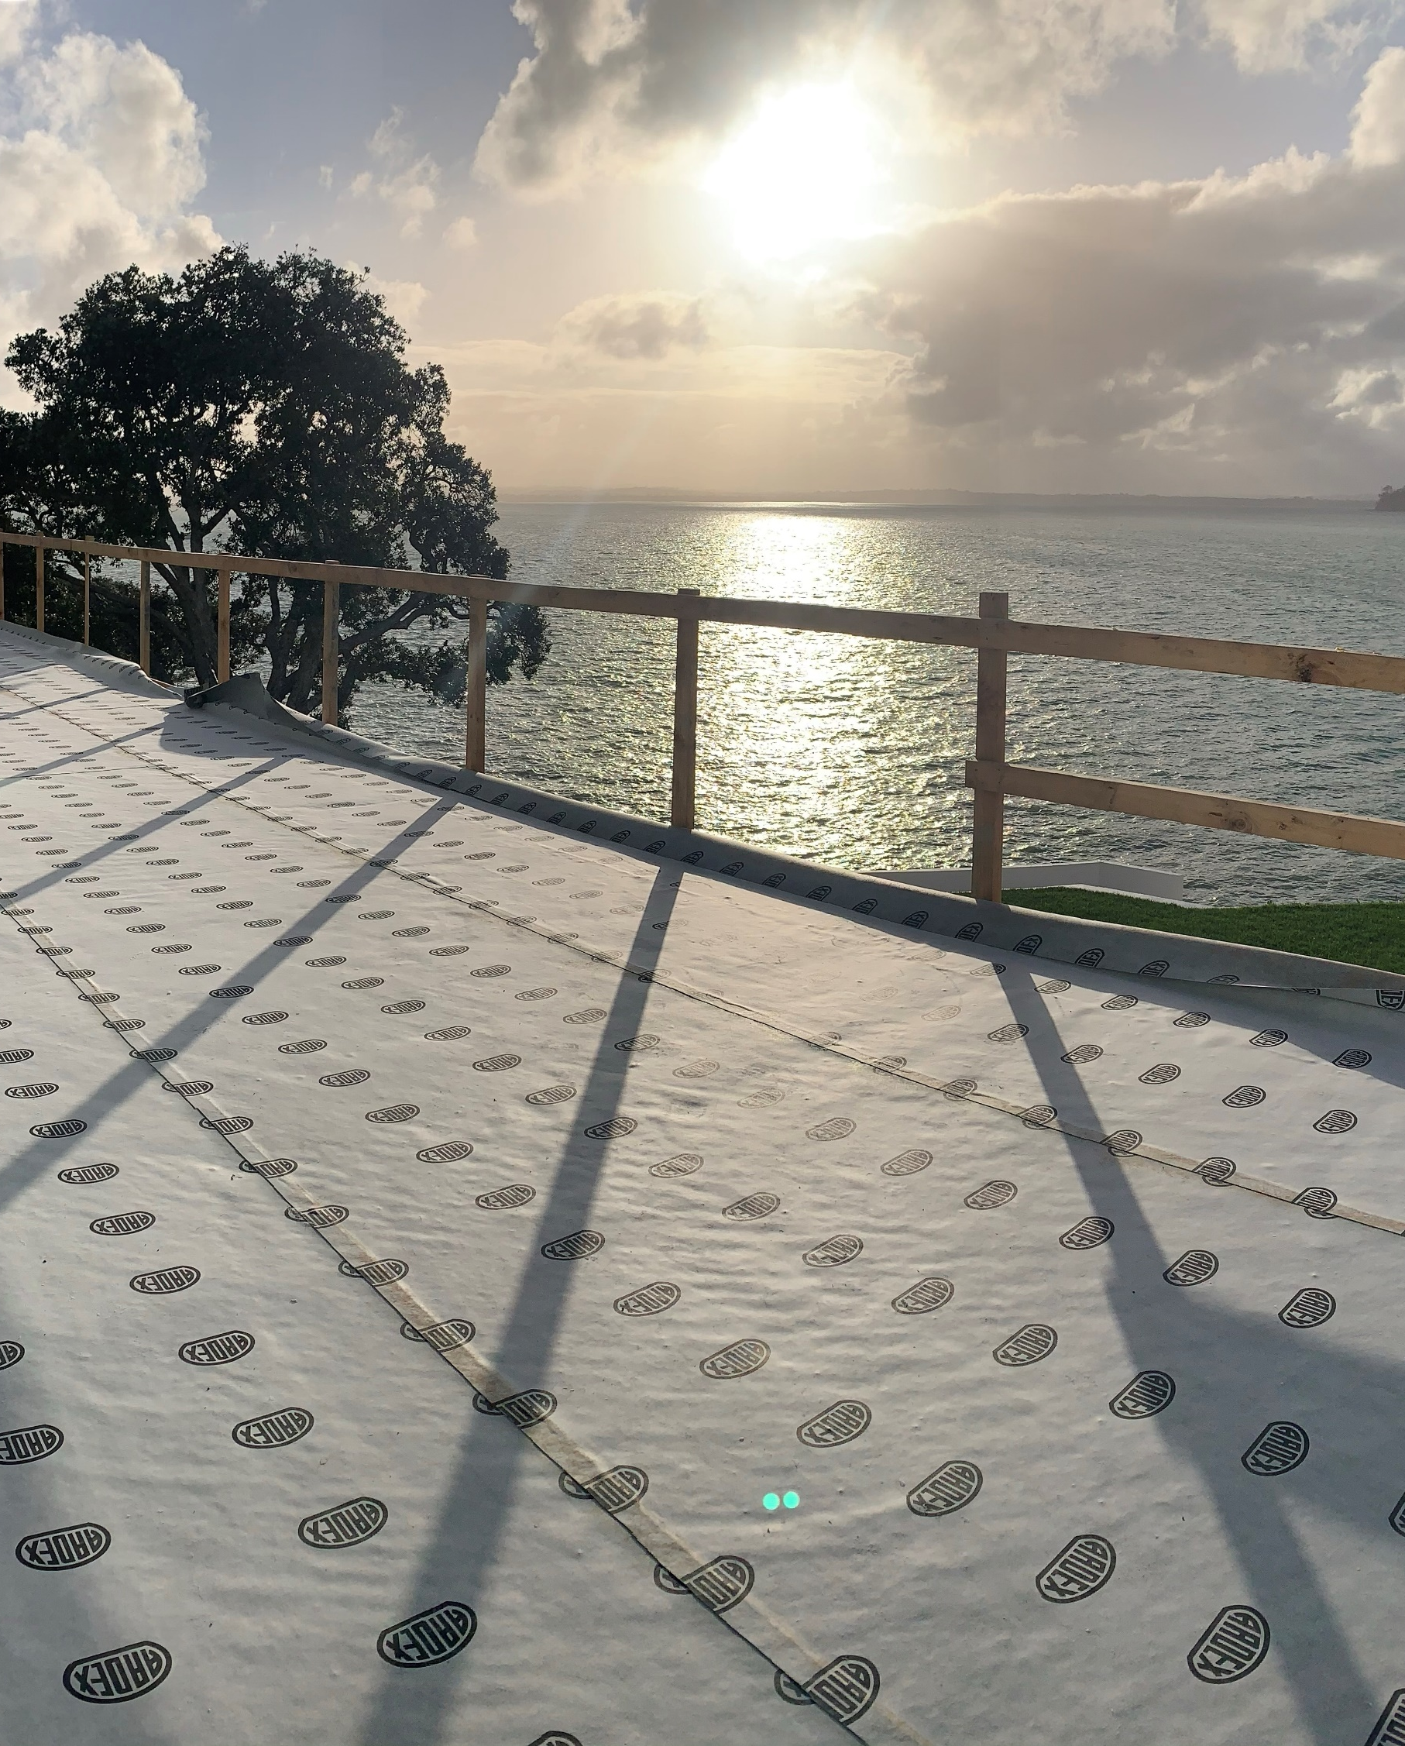
National Specifier Support
Introducing the team
Auckland - Dave Stephenson 0275 330 085
Auckland & Northland Dave.Stephenson@ardex.co.nz
Bay of Plenty – Steve Miles 0272 227 825
Auckland, Bay of Plenty & Waikato Steve.Miles@ardex.co.nz
Wellington - Anthony Howell 0274 850 490
Wellington & lower North Island Anthony.Howell@ardex.co.nz
Christchurch – Andrew Smith 0226 573 247
South Island Andrew Smith@ardex.co.nz

Slide 31
ARDEX.CO.NZ For More Information
In the product section find:
Technical data sheets
Safety Data Sheets
Certifications
In Architectural Services find:
CAD drawings
Building Information Modelling
Register for our newsletter or follow us on social media.

Slide 32
Technical Assistance
ARDEX Support Tools
TECHNICAL SERVICES HOTLINE
ARDEX offer a hotline that gives technical advice for any question or situation
ARDEX Hotline
0800 227 339
When calling it helps to have the following information handy:
Substrate
Internal or external
Unique site information

Slide 33
Thank you
ardex.co.nz

